Slide 1
LACE: Predictive Measure for Readmission Risk Reduction
Presented by: Aaron coyner and Connor Smith

Slide 2
Agenda
Introduction to LACE Score
Demonstrated Need
Implementation
Notes:
Briefly introduce the concept
“Over the next 15 minutes I will introduce a risk score that will help us predict the risk of inpatient readmissions. I will lay out the need for change, introduce you to the model, and discuss how you will play a role in the success of this effort.”
I frequently see analysts spend too much time setting the stage and defining the need for change (next section). Do not fall into this trap. You will run out of time and lose your opportunity to explain the model and how it will help!

Slide 3
Need for change
National Readmission Rate of 15.3% (medicare.gov)
Readmission leads to $41.3B in additional hospital costs
Reduce readmission numbers
Reduce liability
Notes:
Spend a few minutes establishing a fact based need for change. Use existing organizational performance metrics, published studies, and current organizational problems to frame the need for change. Do not introduce editorial or build connections to the future yet. You are using facts to explain the current state.
Again, spending too much time justifying the need for change is the most common analyst presentation trap I witness! Your audience already knows the problems if they work inside the organization. Use this to pinpoint which specific pain points your model will help address.

Slide 4
Alternative
By not changing our process, we expose ourselves to the following:
Increased costs due to readmission
Increased liability due to death/deterioration
Notes:
Build the connection between inaction and the future state with a focus on building the emotional need for change. Connect current problems to likely / plausible future consequences.

Slide 5
LACE: Predictive Measure
LACE Score
Predicts readmission risk
Used to provide further follow up care to high-risk patients
Reduce waste of resources by not providing excessive care to low risk patients
Notes:
Explain the solution at a high level before going into detail.
Skipping the high level and jumping straight to the detail is the second most frequent analyst presentation mistake I see. Give your audience the big picture first so they can better understand and relate to the component parts. This will save you from interruptions and increase their understanding.
The bulk of your presentation should focus on the solution (this section plus the next two)

Slide 6
What LACE takes into account
Major Factors:
Length of Stay
Emergency Room Admission
Comorbidity Scores
Emergency Room Visits
Notes:
Spend time explaining the key components and functions of your model.
It is important that your audience understand the sources of data, calculations, and logic. Using organizational examples and organizational data works better than “dummy data” and pure mathematical calculations.
Think of this section as 25% sales pitch, 25% audience confidence building, and 50% end user training.

Slide 7
Organizational Effect
Physicians will consult the score during/after discharge
Analyze risk, prescribe further care after discharge for high risk patients
Impacts
Decreased financial impact
Improved safety for patients

Slide 8
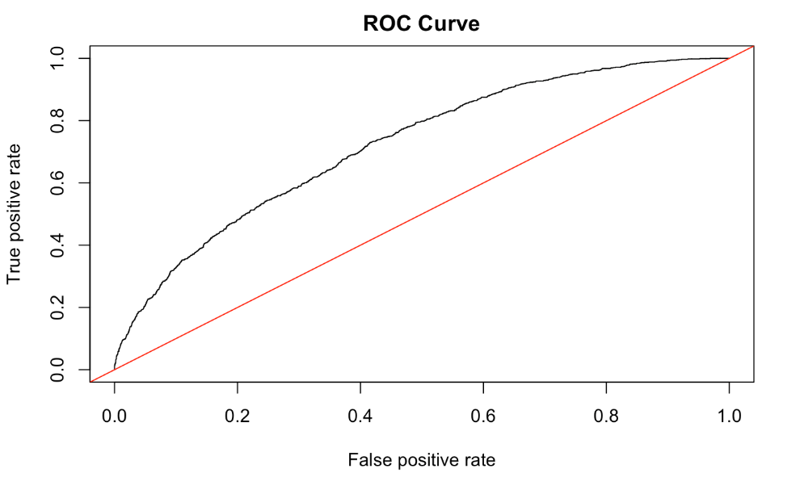
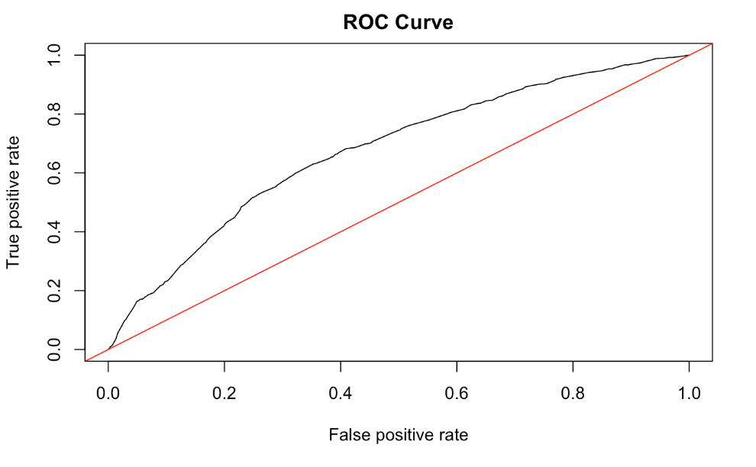
Current Status of LACE
LACE Score currently does not perform well by itself
Including other factors improves predictive power
Current build is not strong enough to justify
AUC: 0.735
AUC: 0.671

Slide 9
What now?
Further research needs to be done into valuable predictive measures for our hospital
Support is needed to investigate improved measures to reduce costs and increase patient care
Notes:
End with action!
Specifically detail what you need your audience to do in order to make this effort a success.
Think of this as the positive benefits that offset the negative consequences you highlight earlier.
Leave your audience with a clear sense of what they need to do individually to drive success when the leave the room.

